Slide 1
WELCOME
2018 INA Winter Meeting
Notes:
Welcome
Introduction

Slide 2
History
Building the Foundation
Meeting in Wilmington, NC
Smart Choice
The Woodlands Financial Group
Indium
Secured Advantage
CMS Insurance Services
Advisory Committee
Sub-committees
Mission, Vision & Value Proposition
Name
Winter Meeting
May 18, 2016
January 30-31, 2017
January 22-23, 2018
Live Oak Bank planning meeting
September 19, 2016
Meeting in The Woodlands, TX
Smart Choice
The Woodlands Financial Group
Indium
Secured Advantage
CMS Insurance Services
ISU Insurance Agency Network
United Valley Insurance Services
Agency Network Exchange
Affordable American Insurance
Select Insurance Markets
Voldico
2nd & 3rd Quarter 2017
INA Winter Meeting
Carrier attendees: Chubb, Travelers, Hartford,
Liberty Mutual, Grange, State Auto, ASI Lloyds,
Utica National, AmTrust, Aegis Insurance

Slide 3
Mission & Vision
Our Mission
We are a forum to collaborate with our industry partners. Our goal is to work together for productive relationships with carriers, associations, channel partners and peers to evolve the collective value of insurance networks.
Our Vision
The Insurance Networks Alliance is the principal organization promoting the critical role of insurance networks to the independent agent distribution channel.

Slide 4
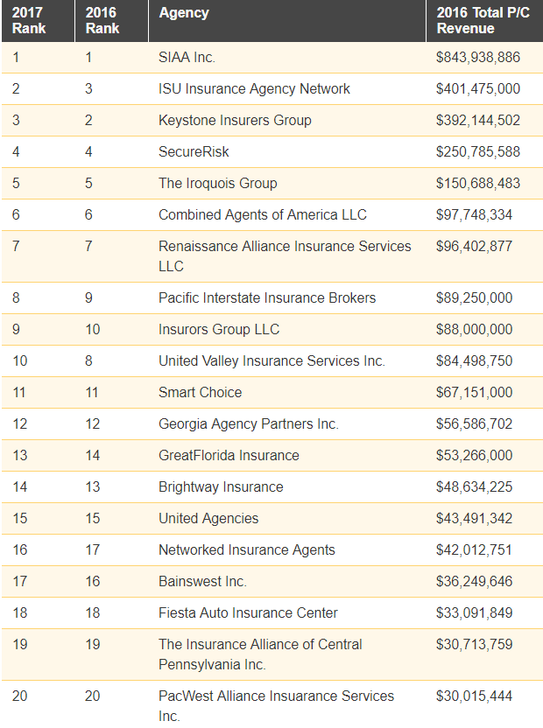
Insurance Networks
2017 Insurance Journal Top 20 Agency Partnerships
$2.9B in revenue
Represent over 17,000 agencies
Most serve multi-state territories
Represent large numbers of national, super regional and regional insurance companies
Variations in number of members, lines of business and average revenue size per member
Mostly personal lines and small commercial focused but not all…
Live Oak Bank Research
75+ P&C focused Networks
Networks Represent 20,000+ agencies
There are more out there…

Slide 5
Insurance Networks
Market Trends
Carrier’s production expectations for directly appointed agents
Former captive agents going independent
Current captive agents needing market access
Carriers looking for efficient agency distribution model
Agents looking for benefits beyond market access from their network relationship

Slide 6
Goals for This Meeting
Raise awareness and provide education concerning opportunities and issues facing Insurance Networks
Confirm there is a need for an Insurance Networks trade group
Answer 3 Questions
Do you see value in the programing provided during this event?
What would you change and why?
Will you come to the next INA event / Join an INA Organization?

Slide 7
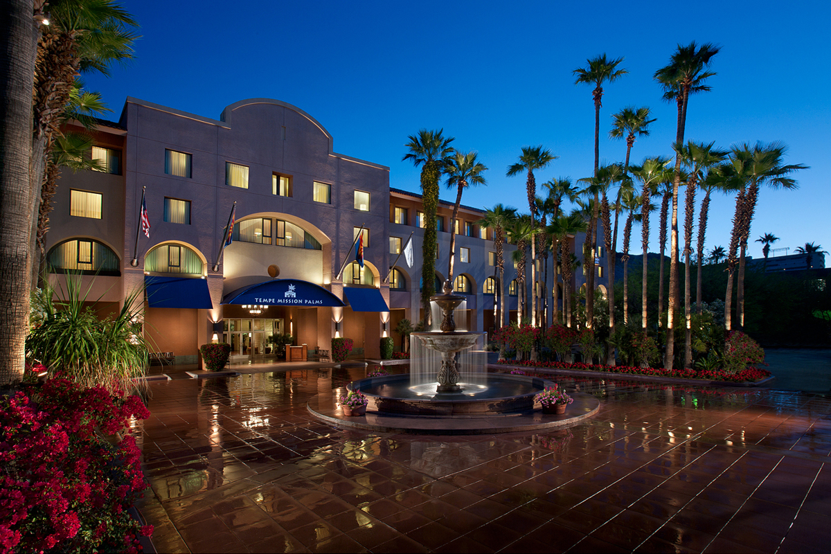
Attendance
28 Networks
28 Carriers / Markets
15 Service Providers

Slide 8
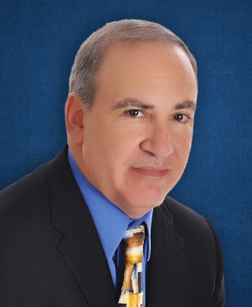
MONDAY AGENda
Up Next…
Working with Member Agencies on Perpetuation, Growth and Acquisition
How to help your agents meet their personal exit objectives while preserving your book of business
Enhancing Network prosperity by assisting high potential agents to grow through acquisition
Jon Persky

Slide 9
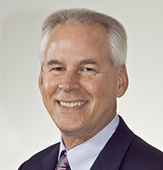
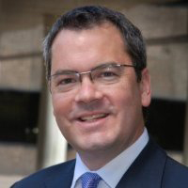
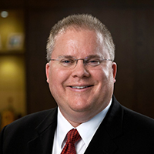
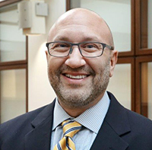
MONDAY AGENda
3:30 pm Carrier Panel Discussion
Carrier expectations for a Networked Group
Critical issues for the Network-Carrier relationship
5:00-6:30 pm Networking Reception
Steve Pearson ISU
Moderator
Paul Morrissette
Chubb
Bryan Fry
Grange Insurance
Doug Avrin
State Auto

Slide 10
tUESDAY Agenda
8:00 am Networking Breakfast
9:00 am General Session
Leading Multigenerational and Millennial Teams in Carrier and Networks
Presented by Coleman Ruiz, Retired Navy SEAL Team Commander
10:30 am Networking Lounge Open
12:00 pm Networking Lunch
1:00 pm Technology Panel
2:00 pm Program Administrator Presentation
3:00 pm Personal Lines, Personal Auto
4:00 pm Wrap-up Session
5:00-6:30 pm Networking Reception

Slide 11
ALLIANCE Sponsors

Slide 12
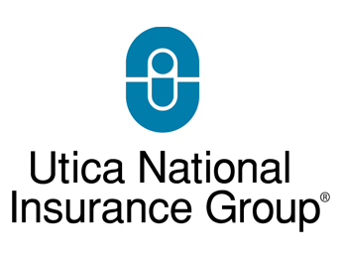
Winter Meeting Sponsors

Slide 13
Perpetuation, Growth & Acquisition
As a national faculty member of the Society of Certified Insurance Counselors for over 20 years, Jon is the Society's exclusive lecturer on Perpetuation, Mergers & Acquisitions, and Agency Valuations. He facilitates these topics as well as many others at Graduate Studies Ruble Seminars and Agency Management Institutes countrywide. Jon is also the author of three books on agency perpetuation including Starting, Buying, Selling and Perpetuating Insurance Agencies.
Jon Persky

